Slide 1
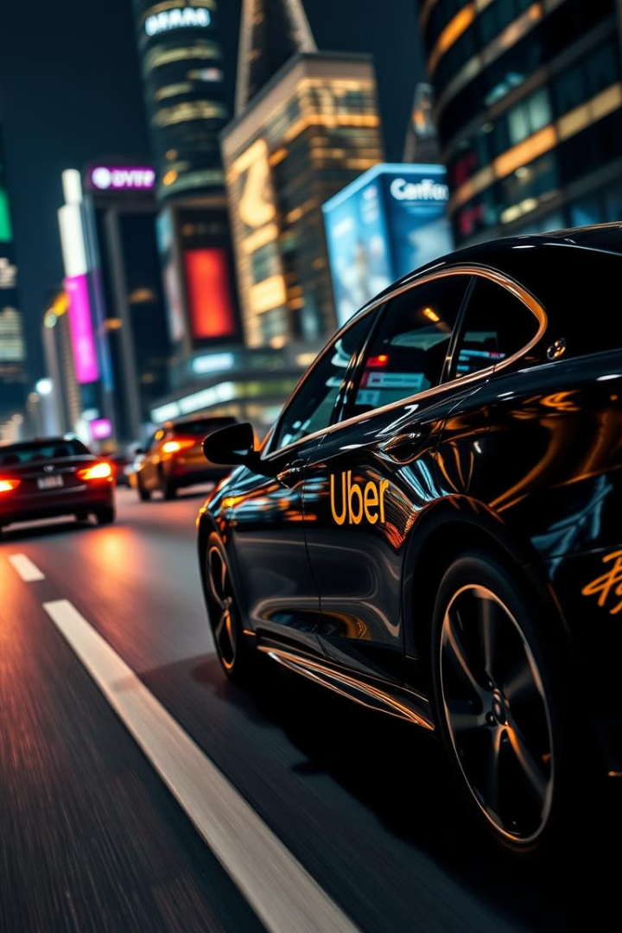
Unlocking Urban Mobility: Uber Trip Analysis
Dive into the power of data to understand Uber trip patterns and enhance urban transportation. This presentation outlines our analysis process, key findings, and actionable recommendations.
A
By Anbunagalakshmi

Slide 2
Data Foundation: Cleaning and Overview
Data Acquisition
Data Cleaning
Data Transformation
Two Excel workbooks
Removed duplicates
Standardized formats
Raw trip data
Handled missing values
Enriched with time attributes
Location details
Corrected inconsistencies
Optimized for analysis

Slide 3





DAX Functions: Powering Insights
CALCULATE
SUMX
Modifies filter context
Sums expression over table
DATESYTD
DIVIDE
Year-to-date calculations
Safe division handling

Slide 4
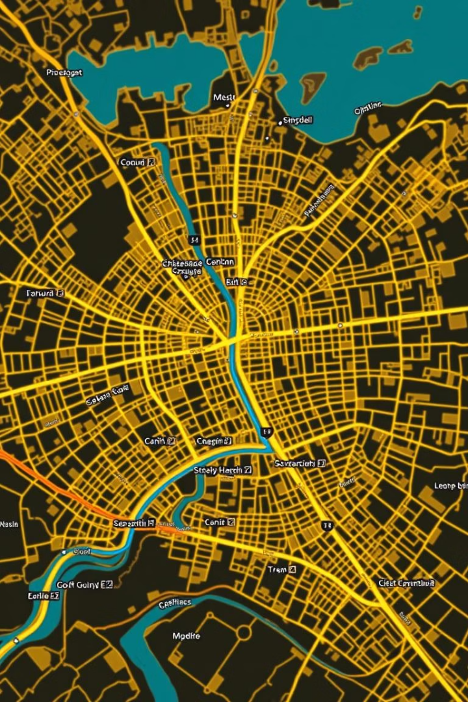
Overview Dashboard: Key Insights
Peak Hours Identified
Popular Pickup Zones
Highest activity during evening commute.
Downtown and entertainment districts surge.
Drop-off Hotspots
Residential areas show consistent demand.

Slide 5

Time Analysis Dashboard: Trends and Patterns
Daily Fluctuations
Monthly Growth
Consistent morning and evening peaks.
Steady increase in overall trips.
1
2
3
Weekly Trends
Weekends drive higher trip volumes.

Slide 6




Geographic Analysis: Understanding Demand
High-Demand Zones
Concentrated in central business districts.
Key Travel Corridors
Connect residential and commercial areas.
Event Impact
Surges around stadiums and venues.

Slide 7








Recommendations: Enhance Business Performance
Optimize Driver Allocation
Match supply to peak demand zones.
Dynamic Pricing Strategy
Adjust fares for demand surges.
Targeted Promotions
Boost off-peak ridership.
Expand Service Areas
Identify underserved neighborhoods.

Slide 8
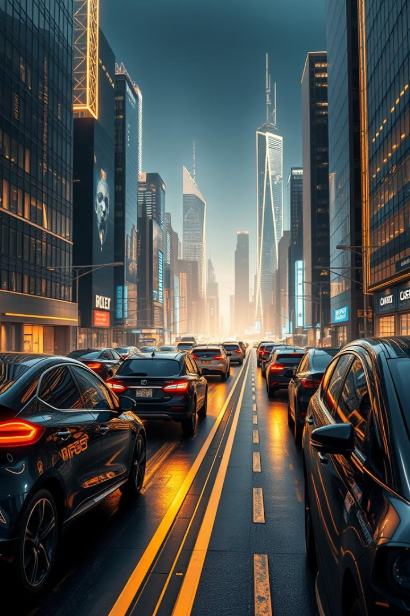
Future Outlook and Next Steps
1
2
Implement pilot programs
Continuous monitoring
Test recommendations in selected areas.
Track key metrics and user feedback.
3
Iterative Improvement
Refine strategies based on results.
Our analysis provides a solid foundation for data-driven decision making. By acting on these insights, Uber can further optimize its operations, enhance customer experience, and drive sustainable growth in the urban mobility landscape.

Slide 9

Thank You.

